Slide 1
CSE460: VLSI Design
Lecture 2

Slide 2
Review of digital logic design

Slide 3
Background
Logic gates (AND, OR, NOT, XOR, etc.)
Boolean algebra
Truth tables
Logic functions
Logic function synthesis by
Sum of Products (SOP)
Product of Sums (POS)
K-maps
Logic blocks (MUX, DEMUX)
Sequential elements (Latch, Flip-flop)

Slide 4
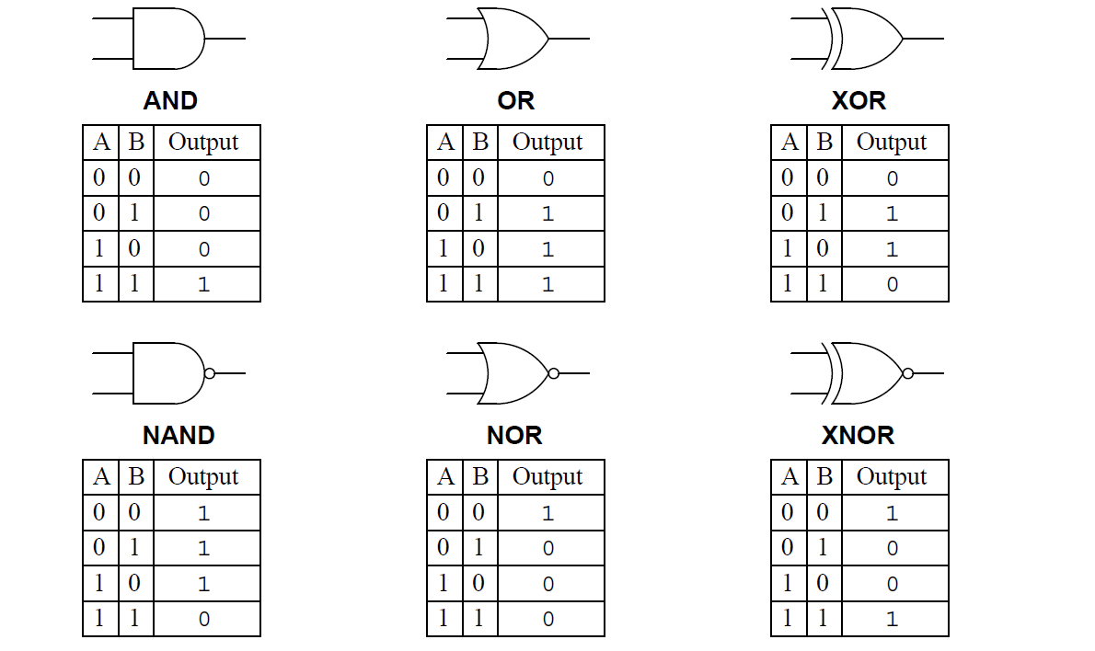
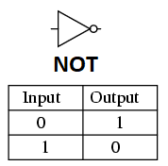
Logic gates

Slide 5
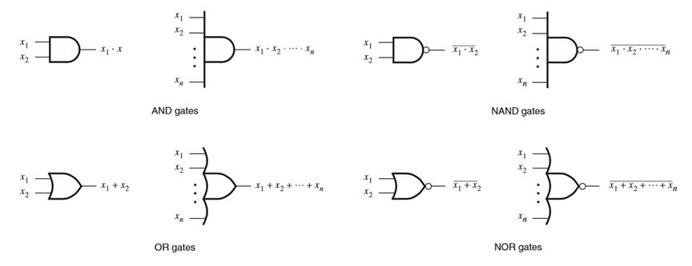
Generalized n-input logic gates

Slide 6
Axioms of Boolean Algebra
1a. 0 · 0 = 0
1b. 1 + 1 = 1
2a. 1 · 1 = 1
2b. 0 + 0 = 0
3a. 0 · 1 = 1 · 0 = 0
3b. 1 + 0 = 0 + 1 = 1
4a. If x = 0, then x’ = 1
4b. If x = 1, then x’ = 0

Slide 7
Boolean Algebra - Single Variable Theorems
5a. x · 0 = 0
5b. x + 1 = 1
6a. x · 1 = x
6b. x + 0 = x
7a. x · x = x
7b. x + x = x
8a. x · x’ = 0
8b. x + x’ = 1
9. (x’)’ = x

Slide 8
Boolean Algebra - Two Variable Properties
10a. x · y = y · x Commutative
10b. x + y = y + x
11a. x · ( y · z) = (x · y) · z Associative
11b. x + ( y + z) = (x + y) + z
12a. x · ( y + z) = x · y + x · z Distributive
12b. x + y · z = (x + y) · (x + z)
13a. x + x · y = x Absorption
13b. x · (x + y) = x
14a. x · y + x · y’ = x Combining
14b. (x + y) · (x + y’) = x

Slide 9
Boolean Algebra - Two & Three Variable Properties
15a. (x · y)’ = x’ + y’ DeMorgan’s theorem
15b. (x + y)’ = x’ · y’
16a. x + x’ · y = x + y
16b. x · (x’ + y) = x · y
17a. x · y + y · z + x’ · z = x · y + x’ · z Consensus
17b. (x + y) · (y + z) · (x’ + z) = (x + y) · (x’ + z)

Slide 10
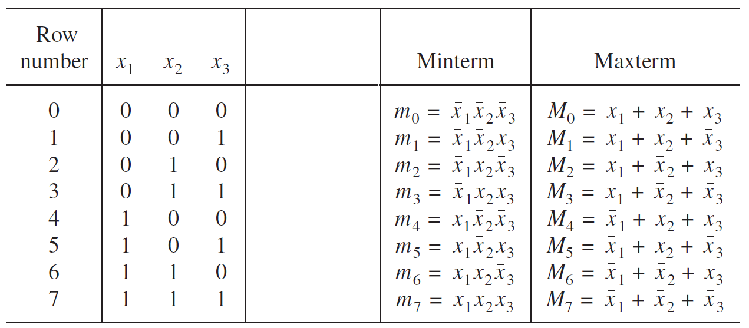
Logic Function Synthesis - Three variable SOP & POS
Function synthesis from truth table
A Minterm m_{i} is a complete argument vector (a,b,c,...,x) for which a Boolean function f(a,b,c,...,x) delivers the value ‘1’. It has “minimum” satisfiability.
A Maxterm M_{i} is a complete argument vector (a,b,c,...,x) for which a Boolean function f(a,b,c,...,x) delivers the value ‘0’. It has “maximum” satisfiability.
SOP: Sum of product
ABC’+B’CD+ABCD+AD’
A→1, A’→0
POS: Product of sum
(A+B+C’)(A+D’)(B’+C+D)
A→0, A’→1

Slide 11
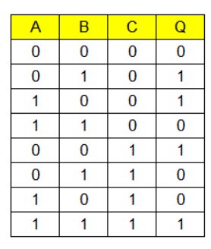
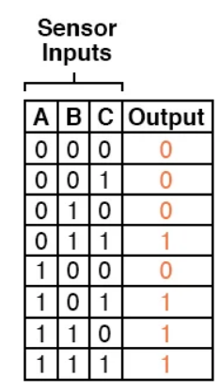

Logic Function Synthesis - Three variable SOP & POS
Example: 01: Write down the Boolean expression in SOP form that describes this truth table
Example: 02: Write down the Boolean expression in POS form that describes this truth table

Slide 12
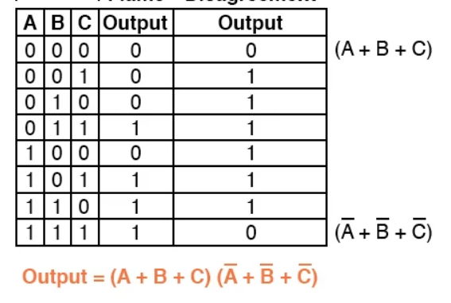
Logic Function Synthesis - Three variable SOP & POS
Example: 01: Write down the Boolean expression in POS form that describes this truth table

Slide 13
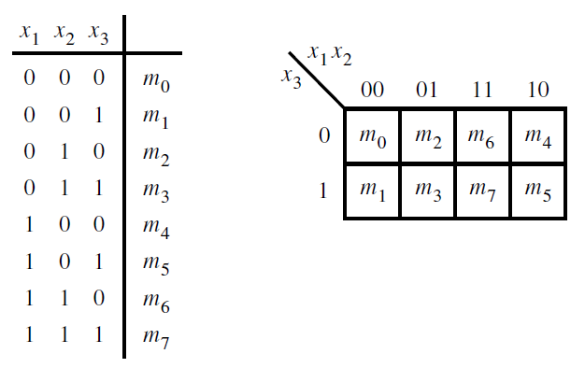
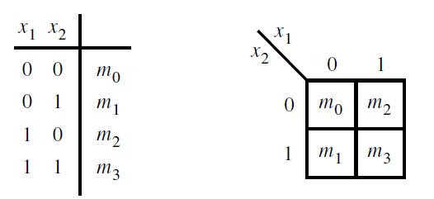
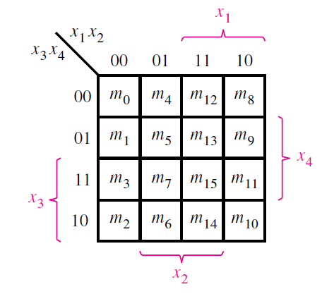
Logic Function Synthesis - 2/3/4 variable k-map
Function synthesis using k-maps

Slide 14
Logic Function Synthesis - 2/3/4 variable k-map
Function synthesis using k-maps
No zeros allowed.
No diagonals.
Only power of 2 number of cells in each group. (2⁰=1, 2¹=2, 2²=4, 2³=8, etc.)
Groups should be as large as possible.
Every 1 must be in at least one group.
Overlapping allowed.
Wrap around allowed.
Fewest number of groups possible.
Visit: http://www.ee.surrey.ac.uk/Projects/Labview/minimisation/karrules.html

Slide 15
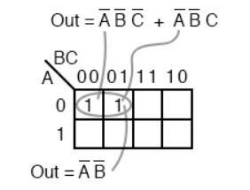
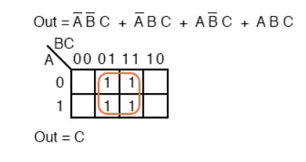
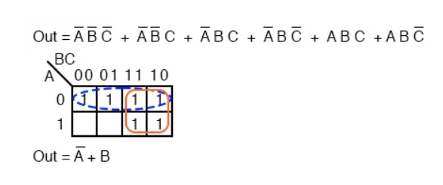
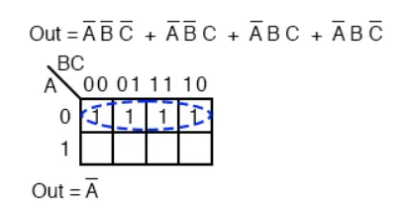
3 variable K-Map
Example: 01
Example: 03
Example: 04
Example: 02

Slide 16
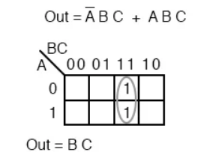
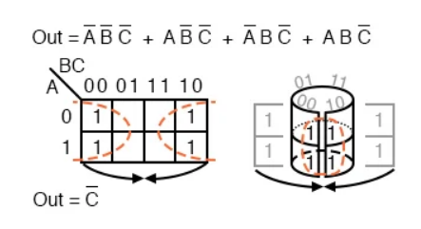
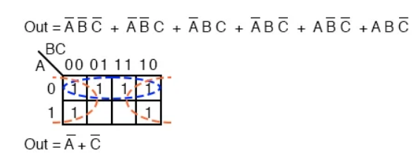
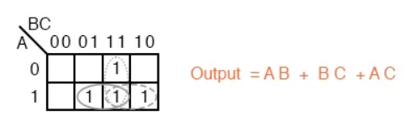
3 variable K-Map
Example: 05
Example: 06
Example: 08
Example: 07

Slide 17
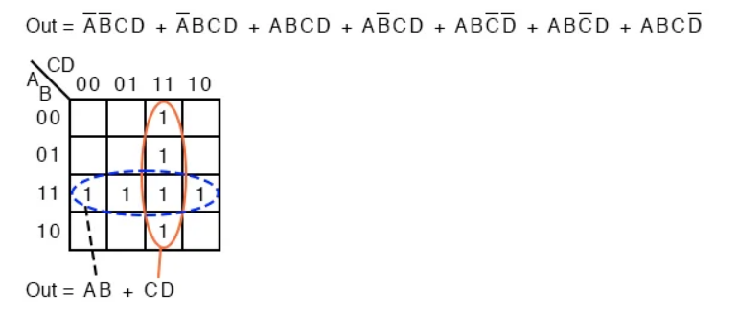
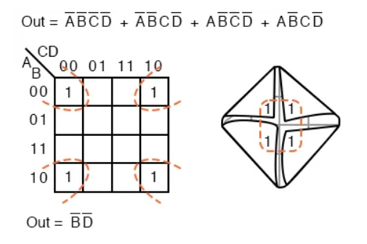
4 variable K-Map
Example: 01
Example: 02

Slide 18
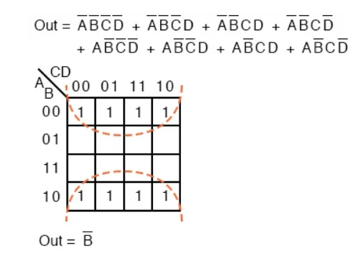
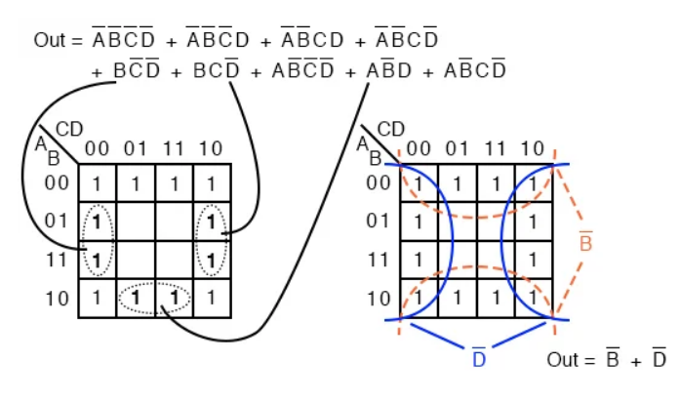
4 variable K-Map
Example: 03
Example: 04

Slide 19
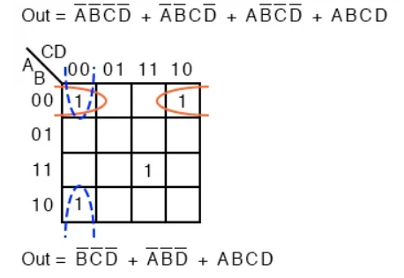
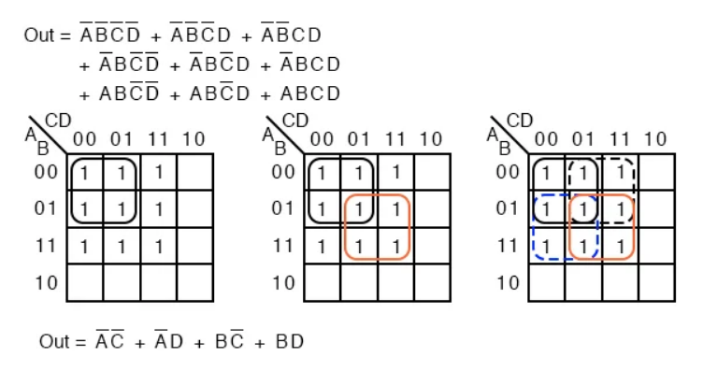
4 variable K-Map
Example: 05
Example: 06

Slide 20
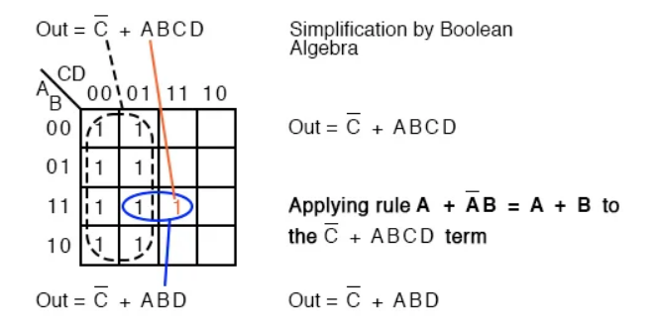
4 variable K-Map
Example: 07

Slide 21
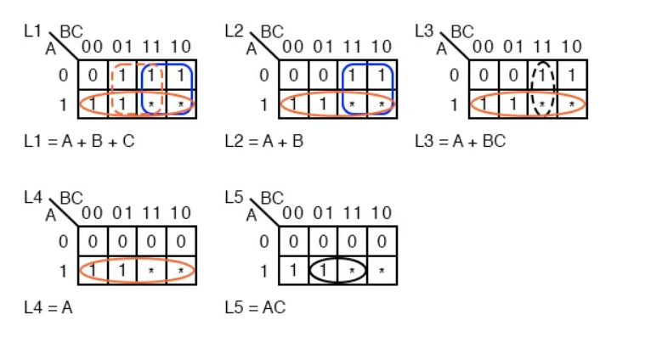
Don’t Care Condition
Example: 01
*** Don’t care cells may be used as either 1s or 0s, whichever is useful

Slide 22
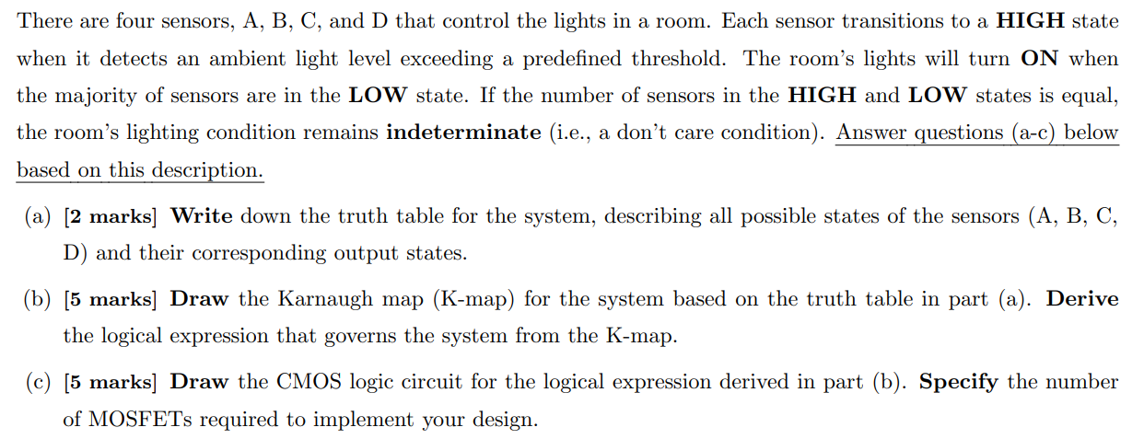

Slide 23
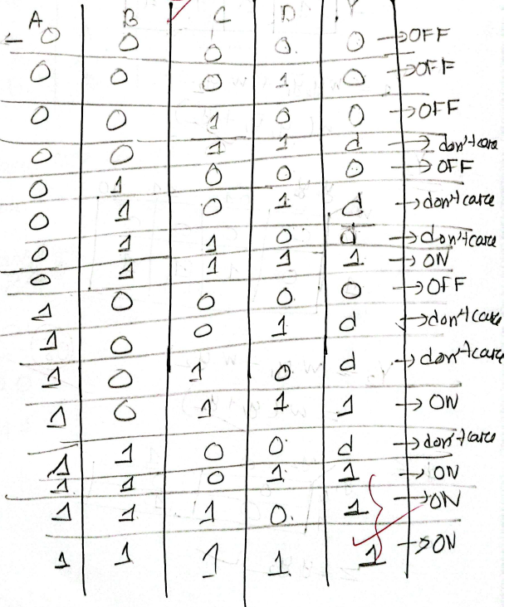
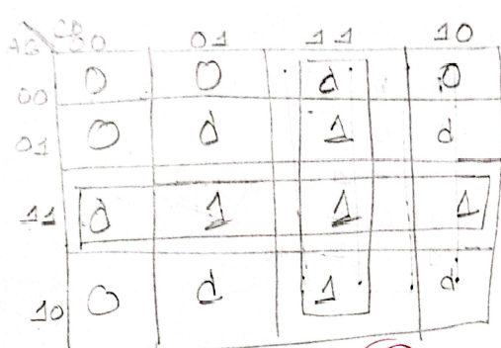

Slide 24
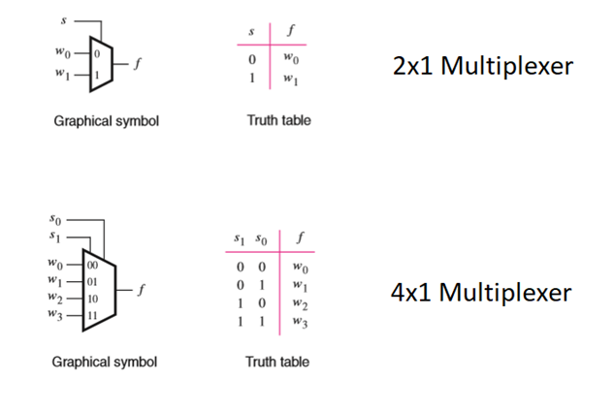
Multiplexer
Multiple inputs, single output. Output is chosen by selector pin/s

Slide 25
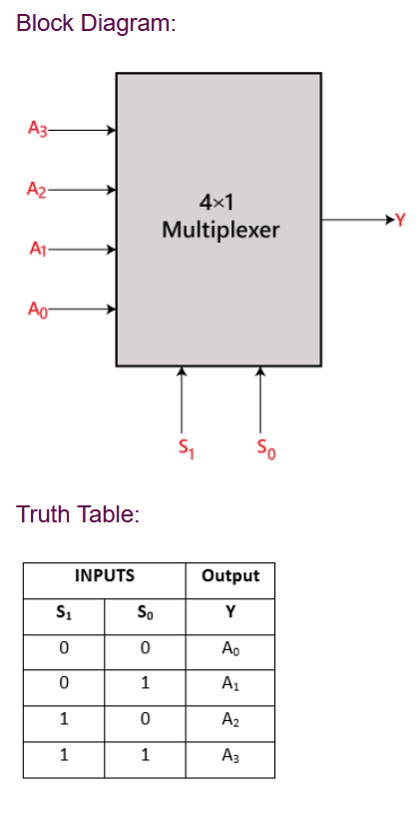
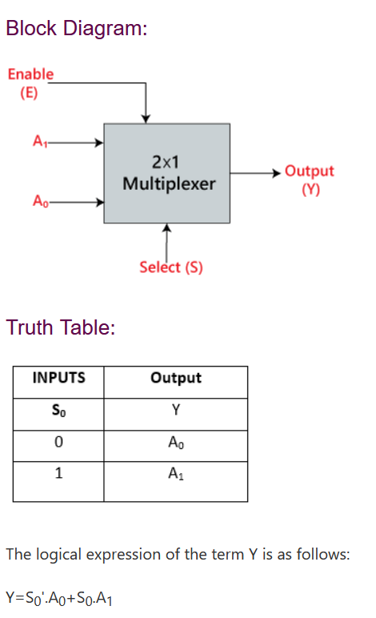
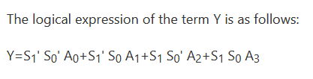
Multiplexer

Slide 26
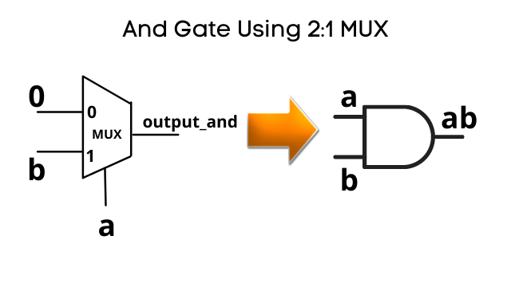
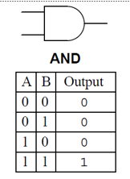
Logic Gates using Multiplexer
B → I₁
A → S
I₀ →0 V

Slide 27
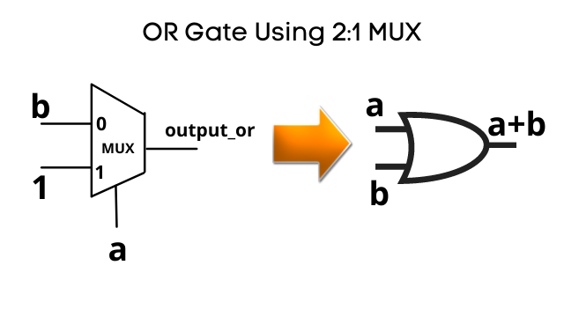
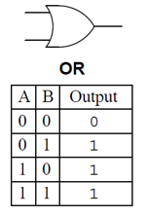
Logic Gates using Multiplexer
B → I₀
A → S
I₁ →5 V

Slide 28
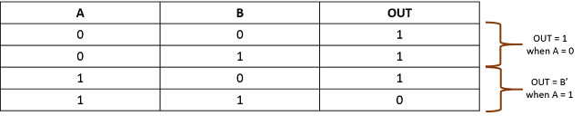
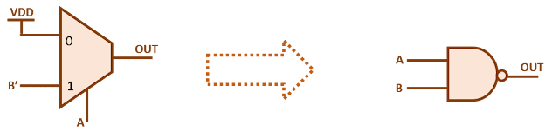
Logic Gates using Multiplexer
NAND Gate using MUX

Slide 29

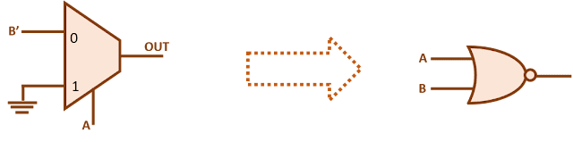
Logic Gates using Multiplexer
NOR Gate using MUX

Slide 30
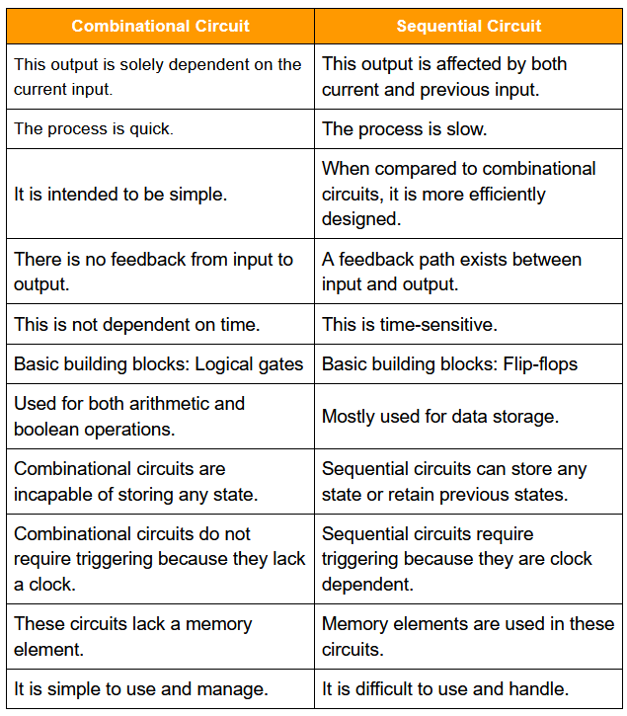
Difference between combinational and sequential circuits
Combinational circuits are built with logic gates such as AND, OR, NOT, NAND, and NOR. These logic gates serve as the foundation for combinational circuits.
Sequential circuits are built with counters, shift registers, latches, etc.

Slide 31
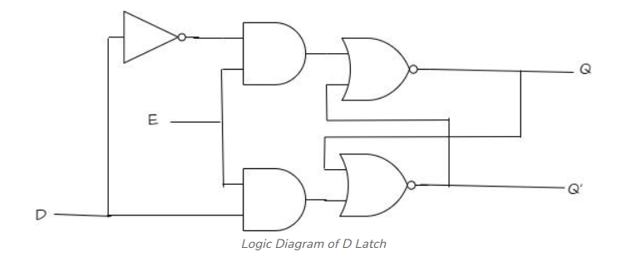
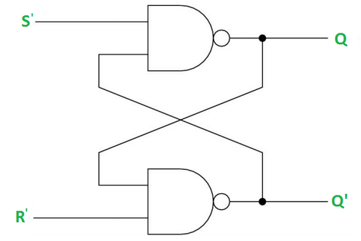
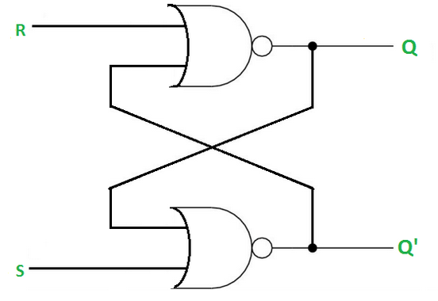
Latch
Latches are digital circuits that can store a single bit of information and hold its value until it is updated by new input signals. Latches are asynchronous.
They are used in digital systems as temporary storage elements to store binary information.
Latches can be implemented using various digital logic gates, such as AND, OR, NOT, NAND, and NOR gates.
Different types of latches: SR (Set-Reset) Latches, Gated SR Latches, D Latches, Gated D Latches, JK Latches, T Laches.
SR latch
D latch

Slide 32
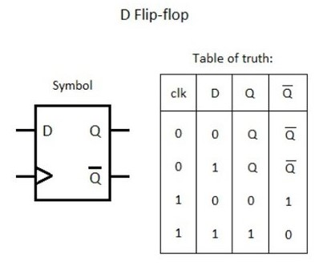
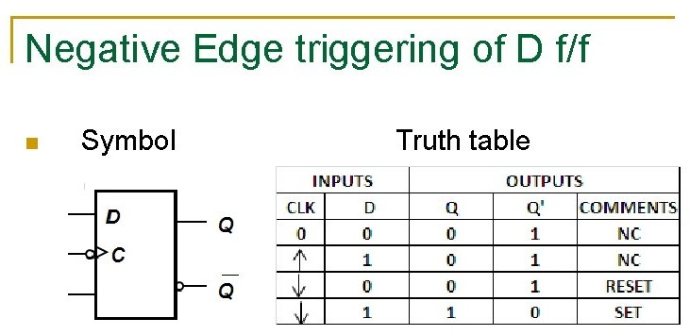
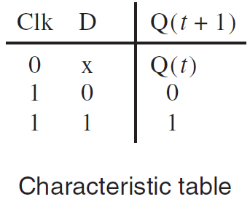
D Latch
Level sensitive element
A positive level triggered D latch
copies D to output Q, if Clock=1, else preserves the previous output
A negative level triggered D latch
copies D to output Q, if Clock=0, else preserves the previous output

Slide 33
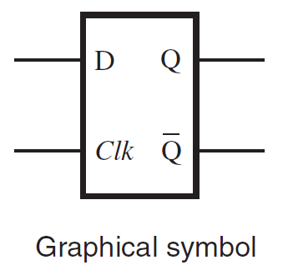
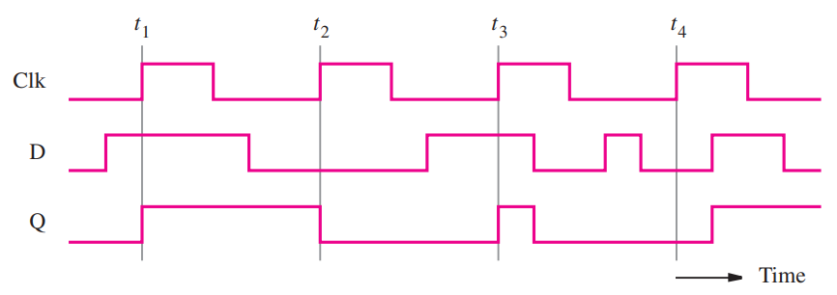
D Latch
Level sensitive element
A positive level triggered D latch
copies D to output Q, if Clock=1, else preserves the previous output
A negative level triggered D latch
copies D to output Q, if Clock=0, else preserves the previous output

Slide 34
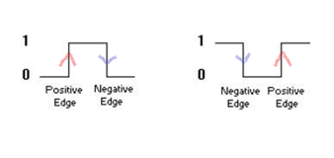

D Flip-flop
Edge sensitive element
Flip-flops are synchronous and operate based on clock signal
A positive edge triggered D flip-flop
Sets Q=D at all positive edges (rising edges) of the clock, retains the old value of Q otherwise
A negative edge triggered D flip-flop
Sets Q=D at all negative edges (falling edges) of the clock, retains the old value of Q otherwise

Slide 35



Building D Flip-flops using D Latches
By cascading a positive level triggered D latch and a negative level triggered D latch we can build a negative edge triggered D flip-flop

Slide 36
Building D Flip-flops using D Latches
By cascading a positive level triggered D latch and a negative level triggered D latch we can build a negative edge triggered D flip-flop

Slide 37

Building D Flip-flops using D Latches
D Flip-flop
The output of the master-slave D flip-flop is similar to the output of a negative edge-triggered D flip-flop (FF)

Slide 38

Level triggered vs. Edge triggered
In level triggered elements
output is affected by the clock levels (high/low)
In edge triggered elements
output is affected by the clock edges (positive edge/negative edge) (rising edge/falling edge)

Slide 39

Level triggered vs. Edge triggered
In level triggered elements
output is affected by the clock levels (high/low)
In edge triggered elements
output is affected by the clock edges (positive edge/negative edge) (rising edge/falling edge)

Slide 40
Slide references
https://instrumentationtools.com/logic-gates/
Stephen Brown & Zvonko Vranesic - Fundamentals of Digital Logic with Verilog Design

Slide 41
Thank you!

